Slide 1
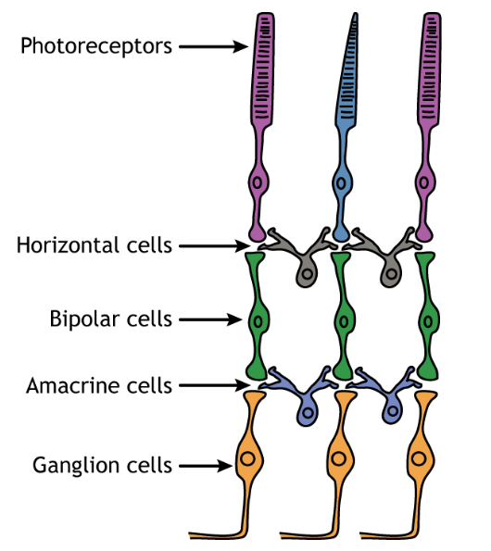
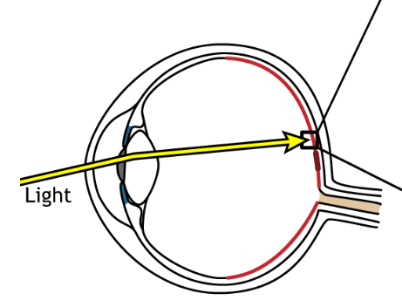
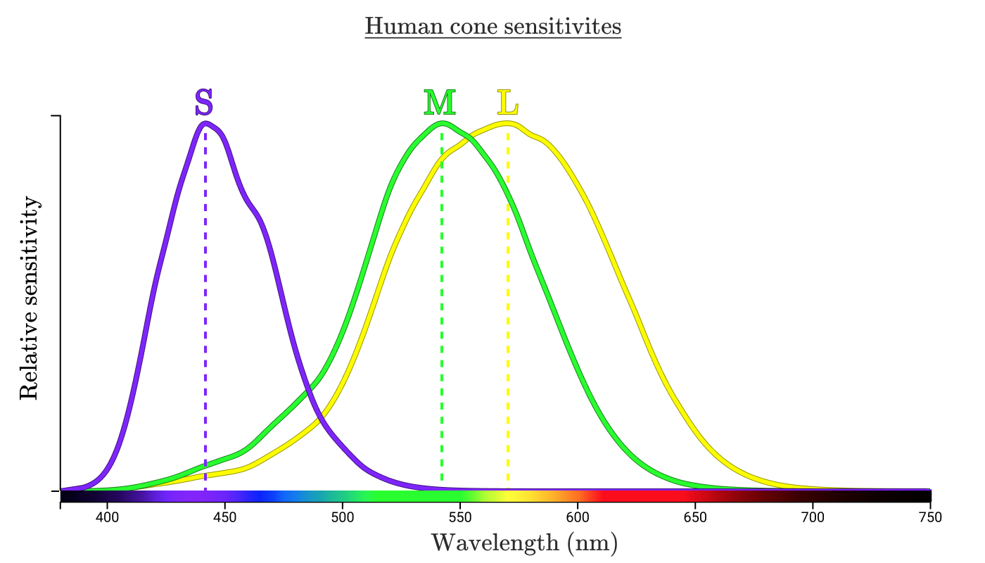
The retina is well-structured into different cell types
Notes:
Retina is a great place to study the functional role of cell types, since we have direct control of the inputs

Slide 2
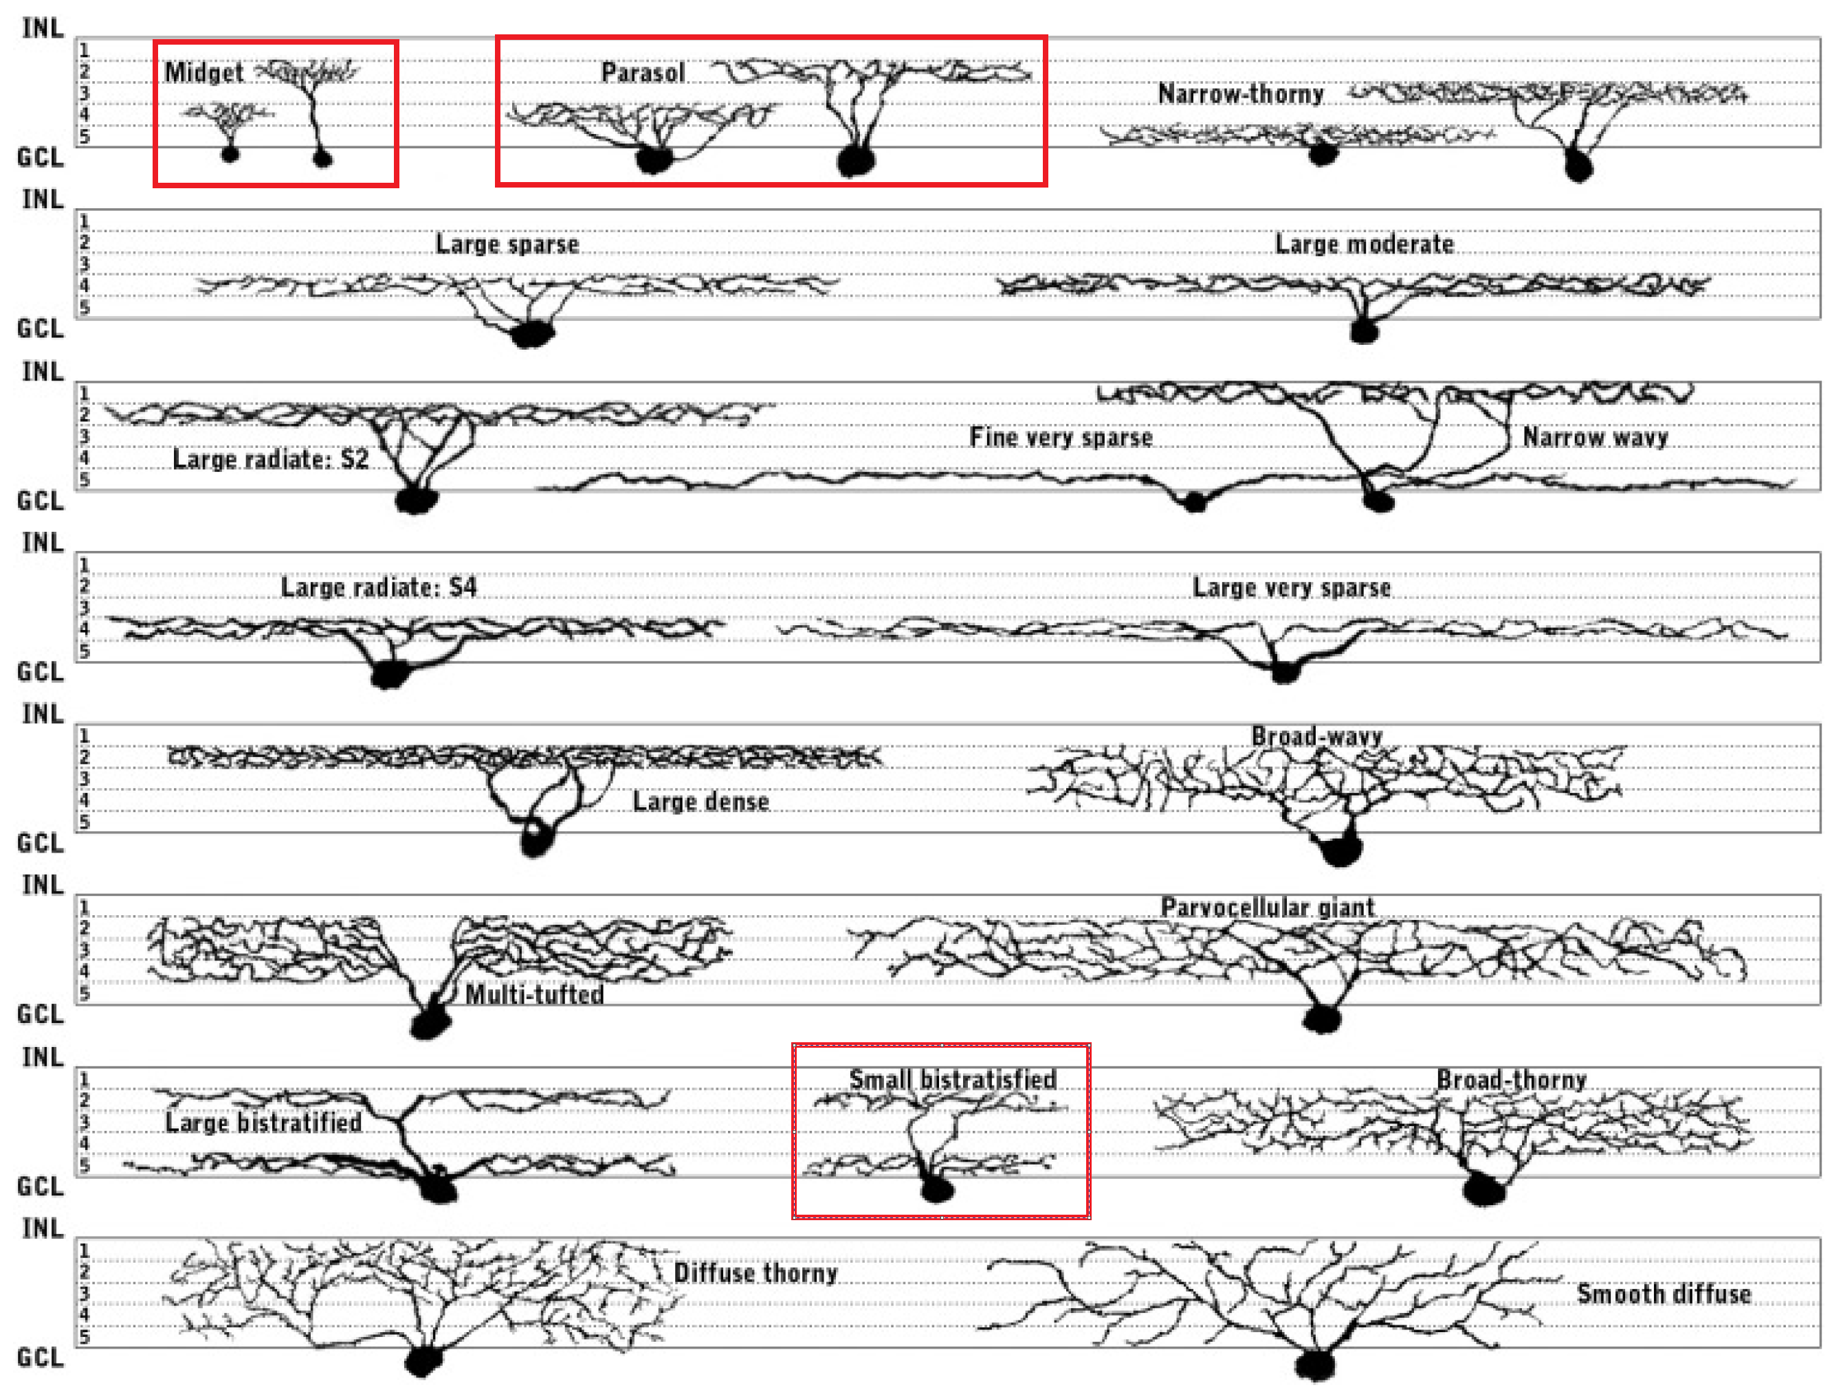
Retinal ganglion cells have many cell types
Yamada, Bordt & Marshak, 2004

Slide 3
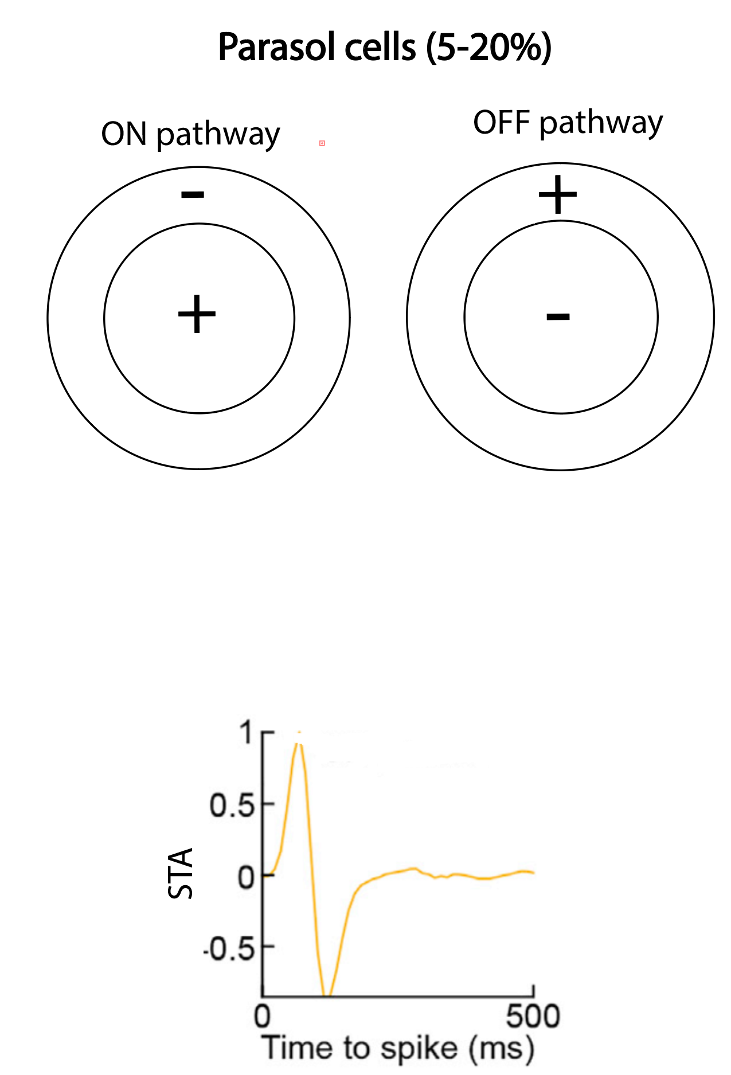
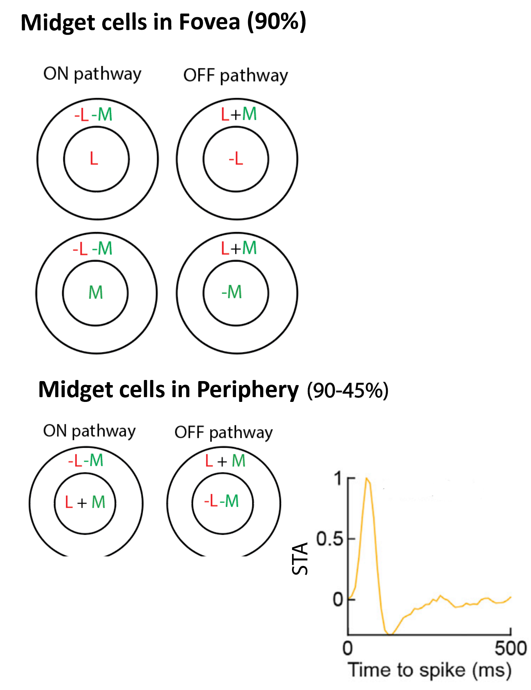
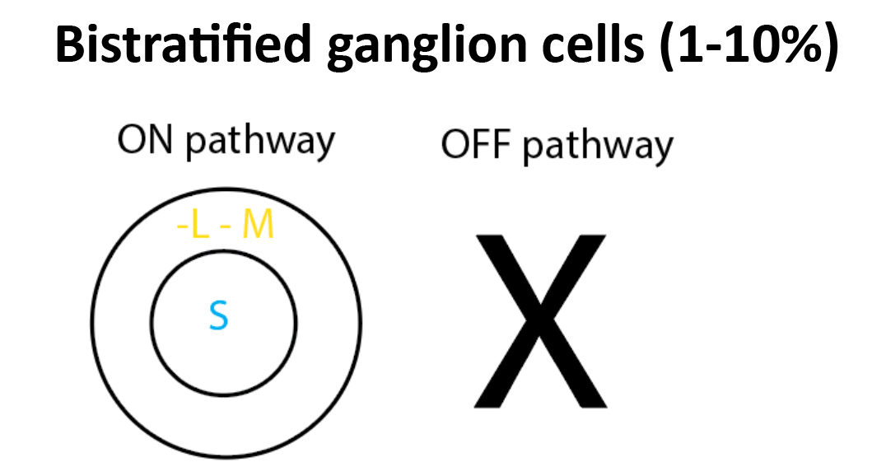
Properties of 3 major cell types

Slide 4
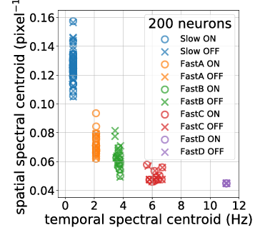
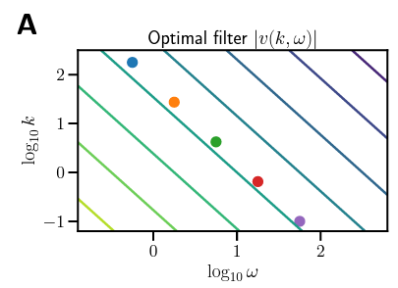
Tradeoff between spatial and temporal frequencies

Slide 5
What about space and time?
There are LMS natural image datasets with static images
There are natural movies dataset in black/white and some in colors
Currently no space-time LMS dataset! I will have to create my own by having my own conversion from RGB to LMS

Slide 6
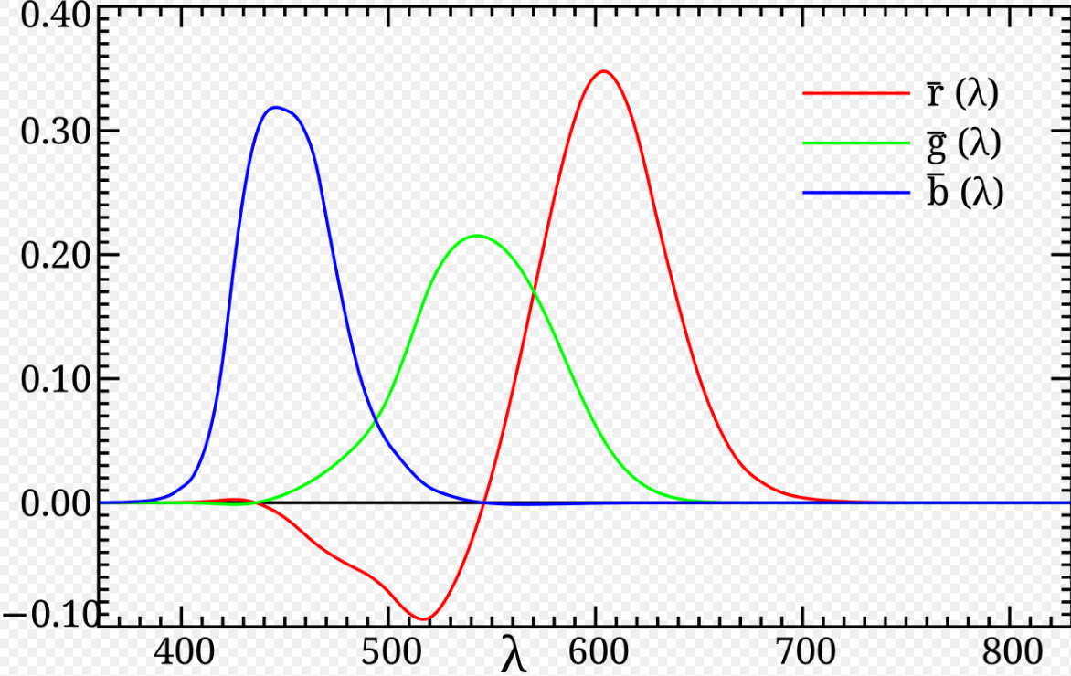
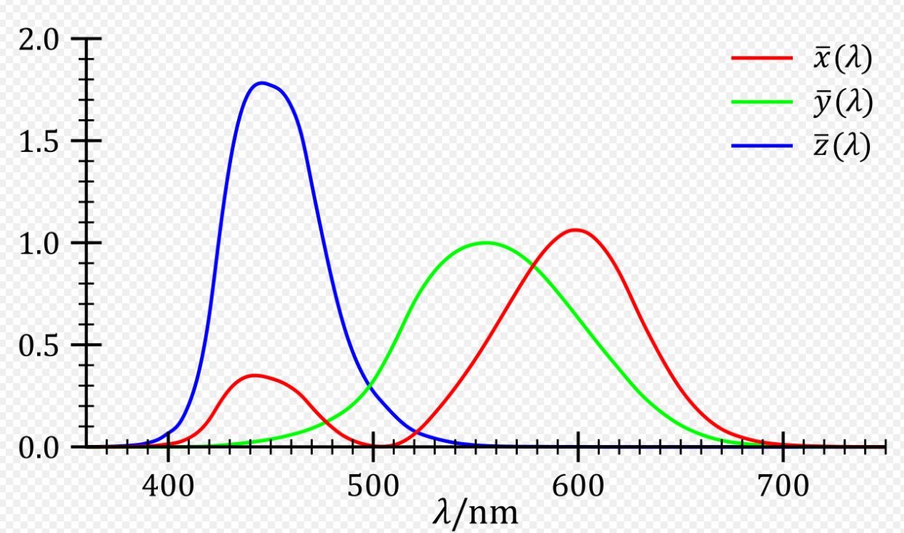
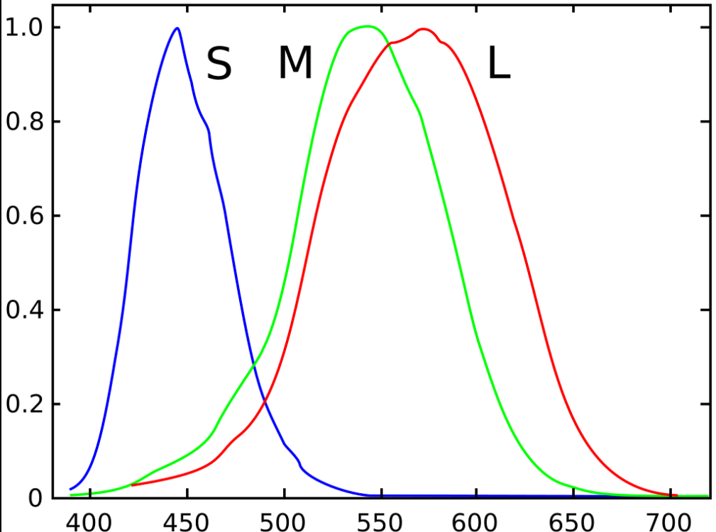
RGB, XYZ and LMS coordinates
RGB
XYZ
LMS

Slide 7
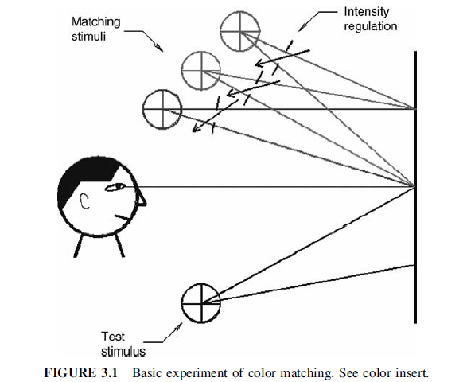
What do these coordinates represent?

Slide 8
RGB, XYZ and LMS coordinates
CIE RGB
XYZ
LMS
Allowed to subtract colors from test stimuli: Allows to replicate all colors
Not allowed to subtract colors from test stimuli = digital RGB
Similar experiment but in dichromats

Slide 9
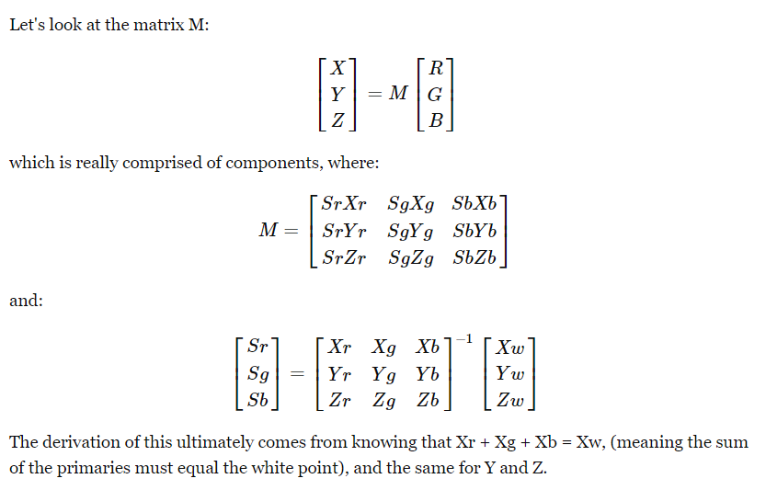
How to go from one set of coordinates to another?
Assume the color spectra is the same as daylight (D65). Taken from physics.stat.exchange:
Thankfully, these 3x3 matrices already exist and I don’t need to make them myself ☺

Slide 10
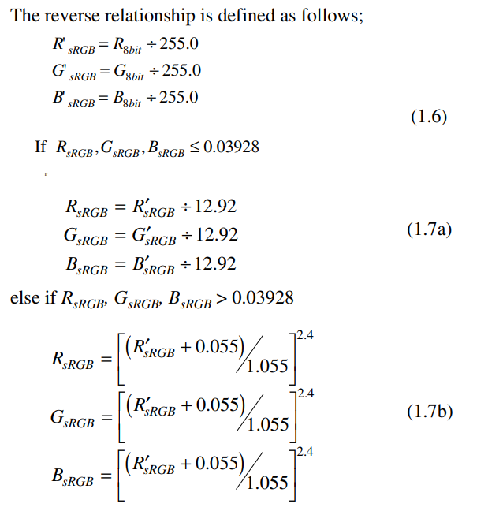
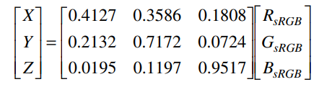
But wait – there’s more! Correction for Gamma nonlinearity. Going from sRGB to linear RGB.
And then from linear RGB to XYZ:

Slide 11
Convert this video from RGB to LMS!
https://www.youtube.com/watch?v=Om60gx_eXTI&t=294s

Slide 12
Next step: Replicate this figure but for each LMS channel

Slide 13
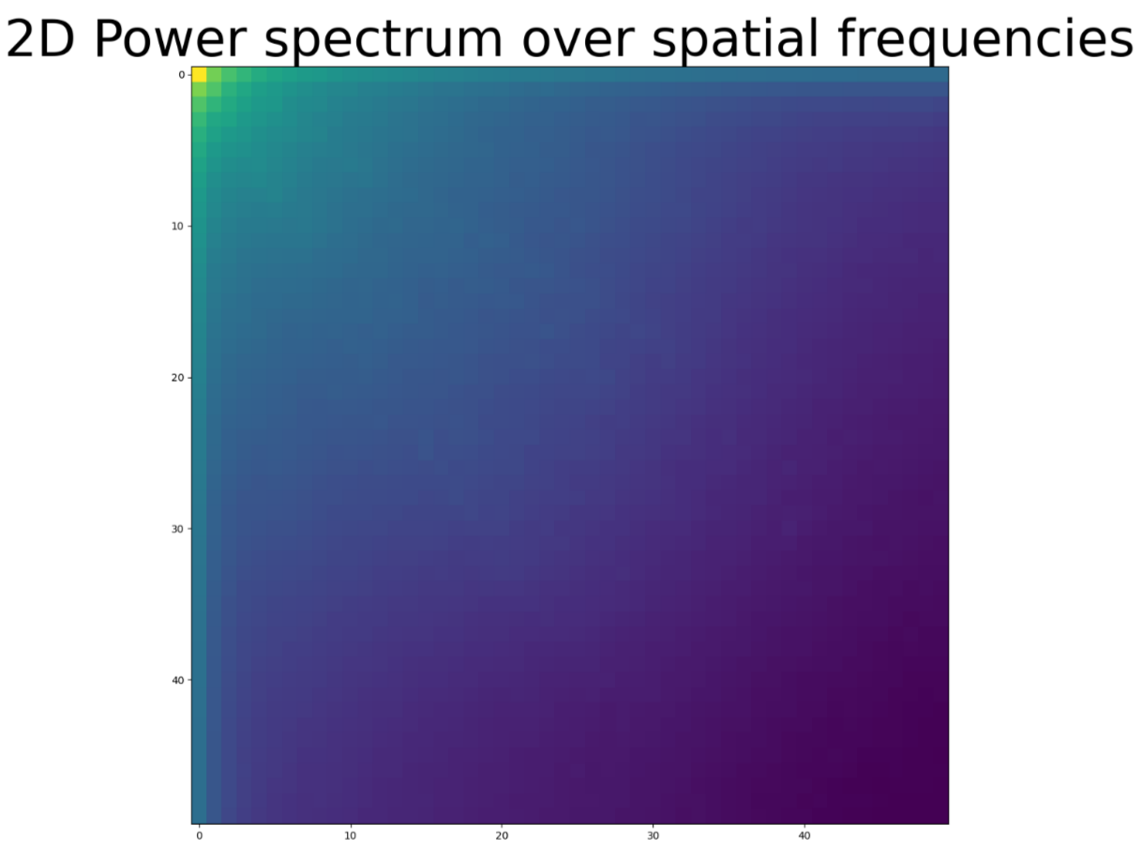

Slide 14
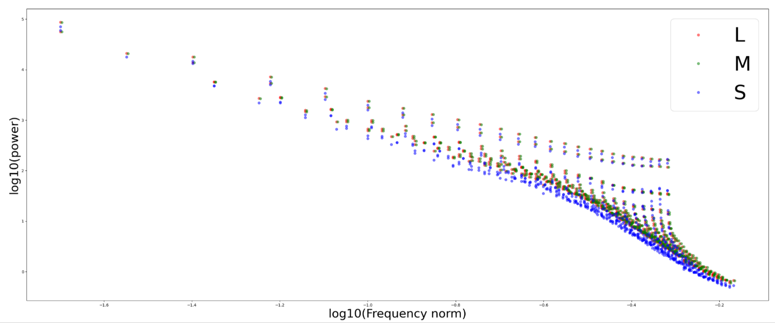
L and M cones have higher power at high spatial frequencies

Slide 15
